Slide 1
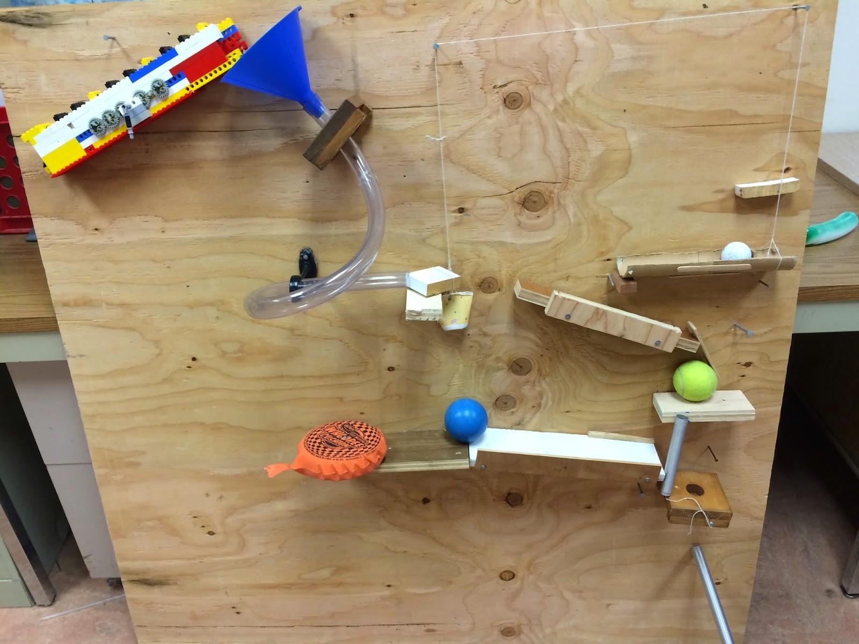
Our Rube Goldberg Machine
Built and Designed by: Simon Swetland, Spencer Shifs, Sarah Teel, and Ryan Tavenner

Slide 2
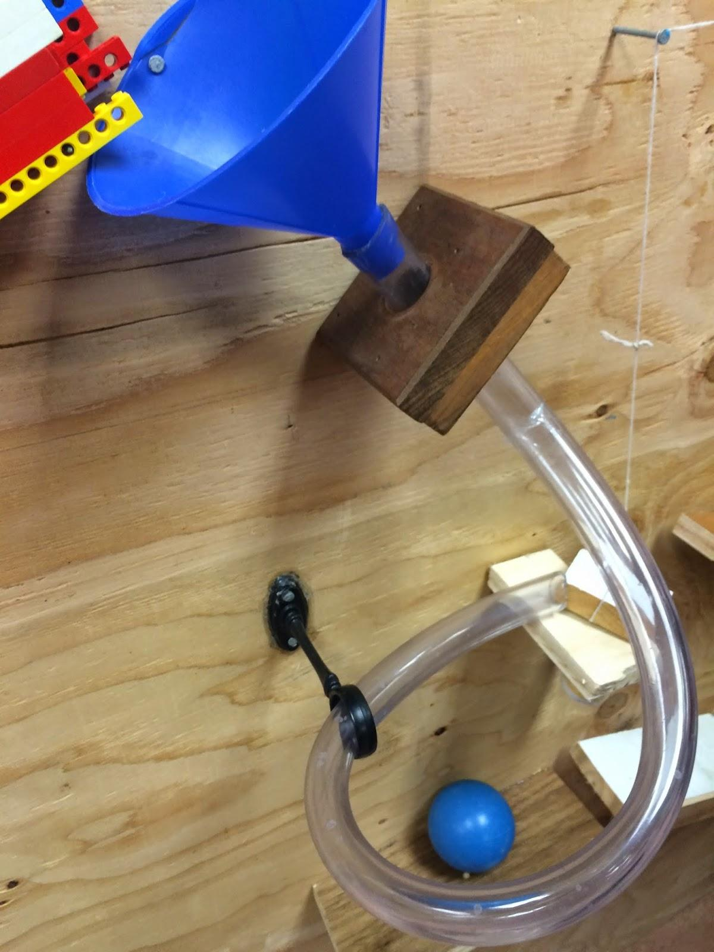
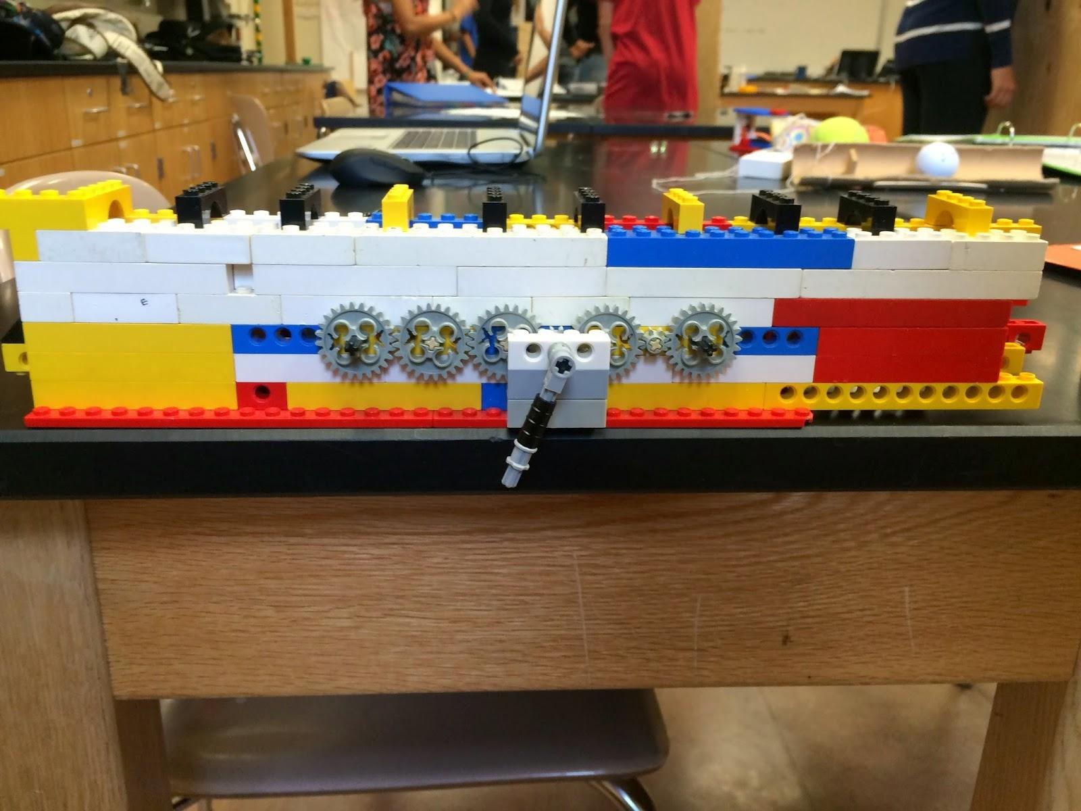
Steps 1 and 2: The Marble
Step 1: The Marble Elevator
Step 2: The Funnel and Screw
A marble gets pushed along an escalator-like track fueled by a wheel-and-axle system. It’s Mechanical Advantage is 8.
The marble comes out of the elevator and then gets dropped into the funnel which directs the marble into the screw. The marble lost 83% of its force to friction.

Slide 3
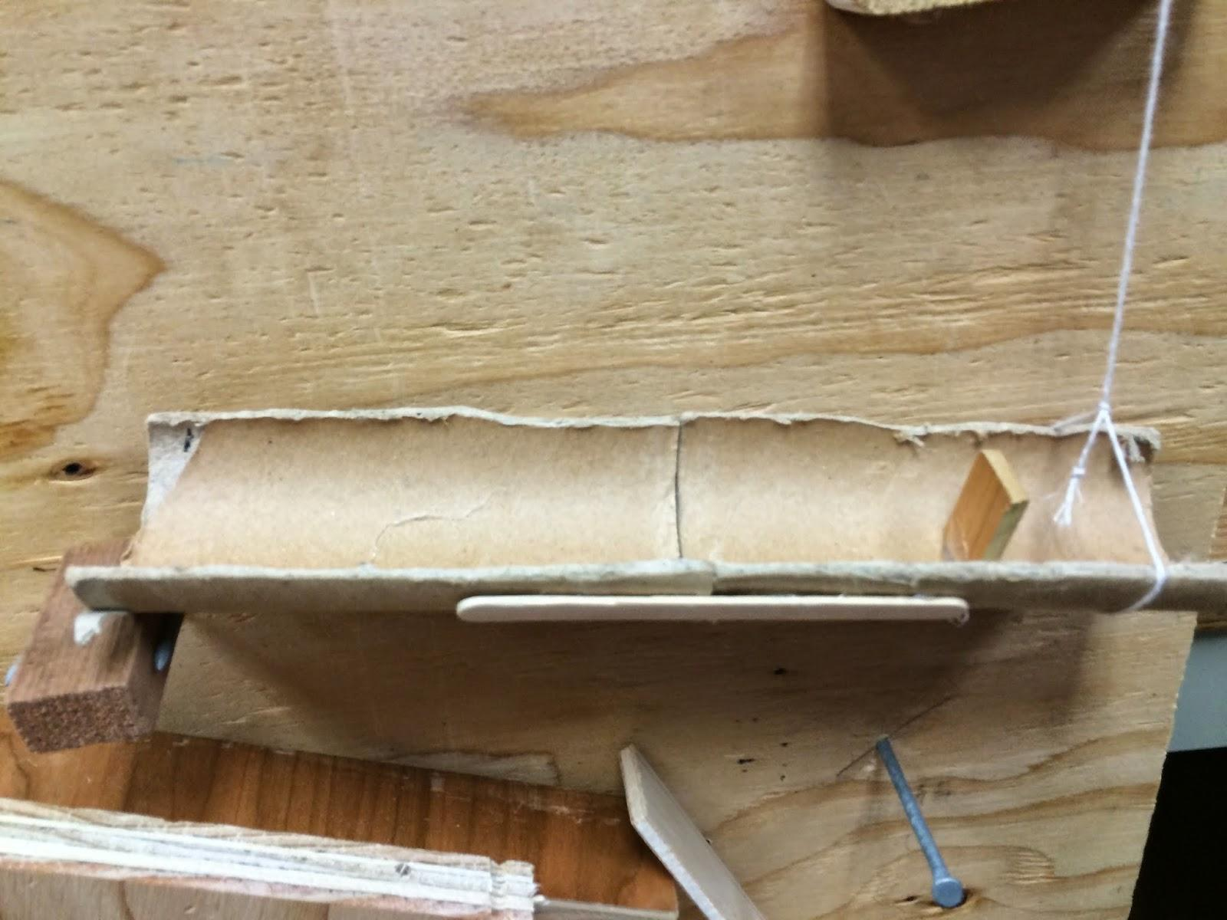
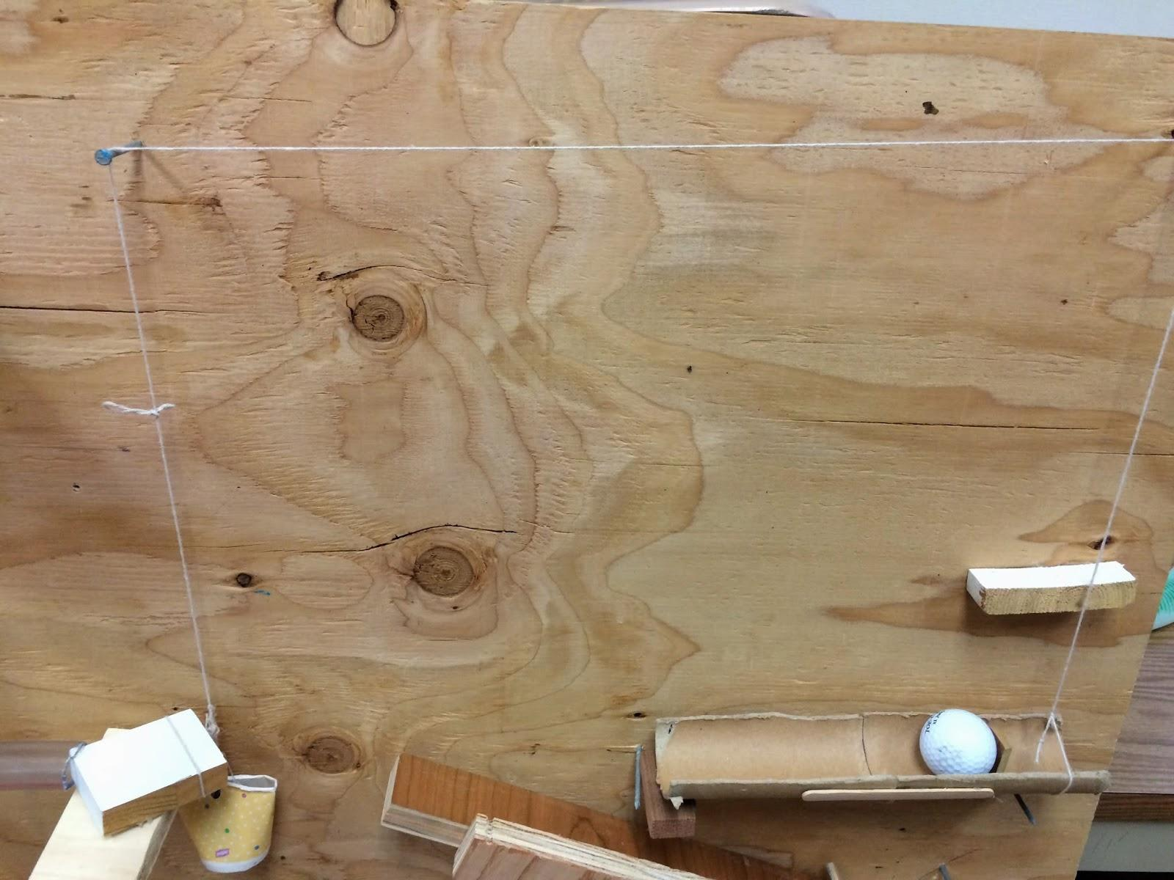
Steps 3 and 4:The Pulley and Lever
Step 3: The Pulley System
Step 4: The Lever
The marble hits a block which causes it to fall over, giving the pulley system enough weight to activate. This lift up a lever with a golf ball laying on it. 0.0018 Joules were impacted on the block.
When the pulley system activates, it raises this lever up, allowing a golf ball resting on the block in the back to roll down. It is a class two lever with a mechanical advantage of 1.104

Slide 4
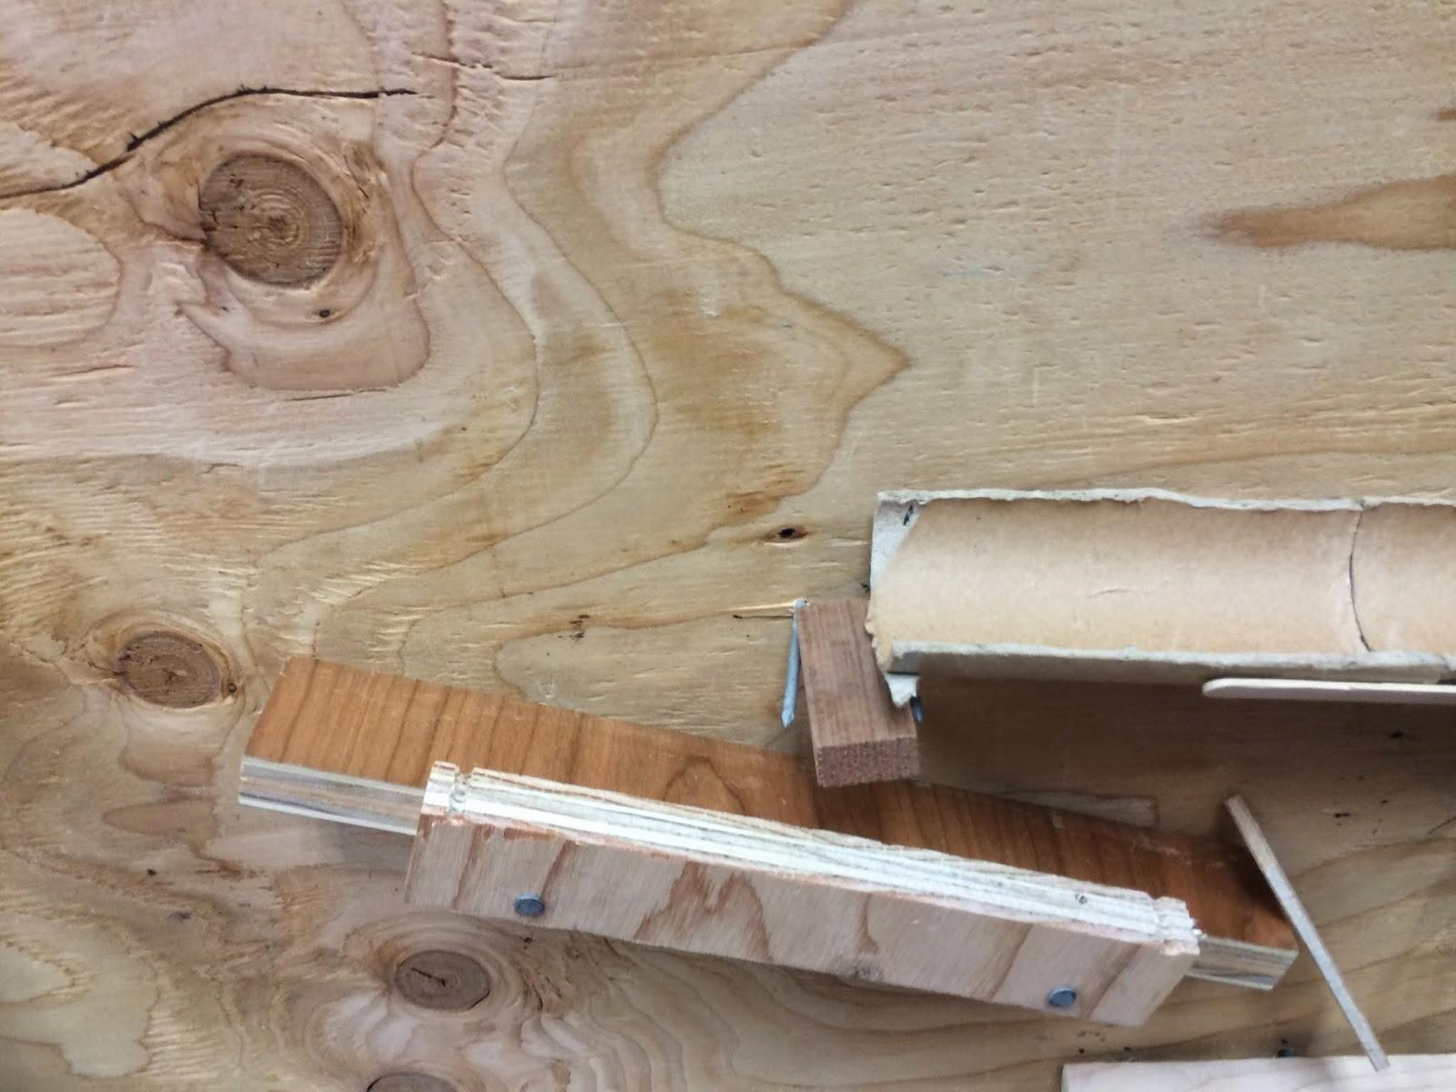
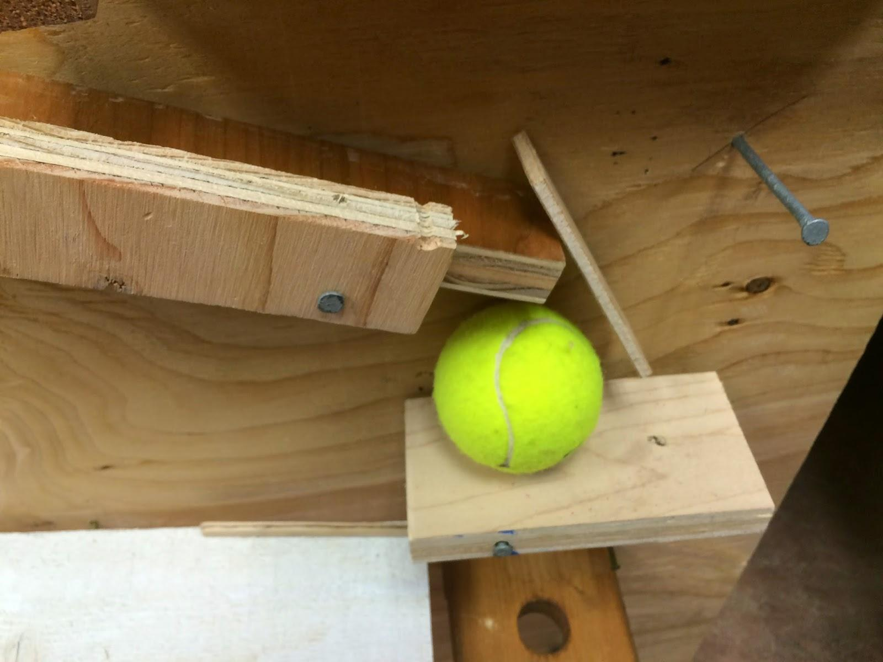
Steps 5 and 6: The Golf and Tennis balls
Step 5: The Golf Ball Incline
Step 6: The Swivel and the Tennis Ball
The golf ball rolls down the lever and falls onto an incline plane which takes the golf ball up to a swivel. The Mechanical Advantage is 3.
The golf ball hits the “swivel” shown below. It is in essence a lever turned upright which when hit on the top, will throw the bottom forward knocking a tennis ball down onto a lever. The impulse on the swivel is 0.38Ns

Slide 5
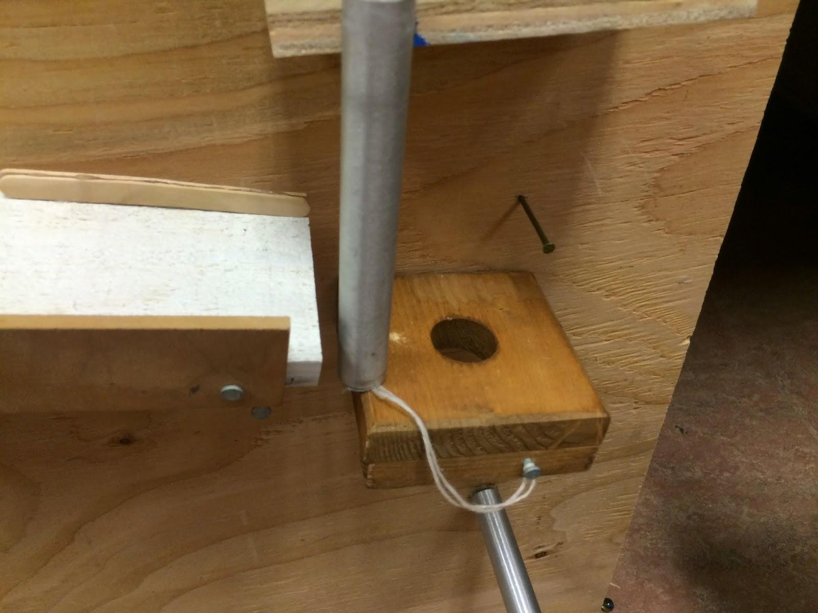
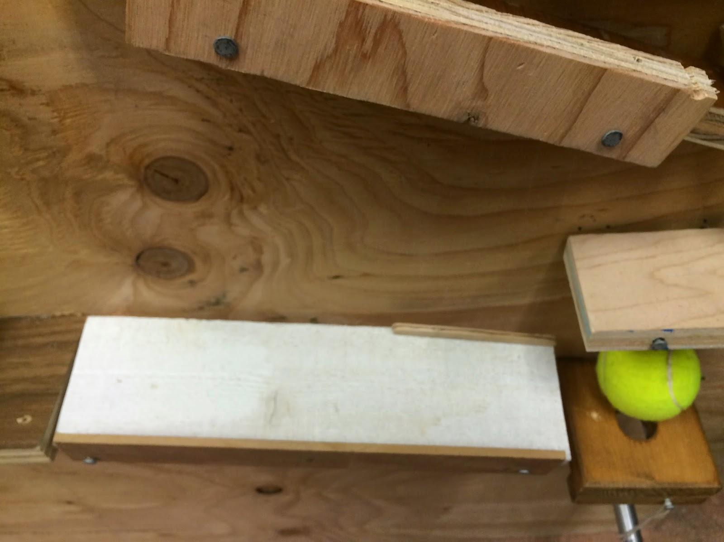
Steps 7 and 8: The Big Lever and Ending 1: part 1
Step 7: The Big Lever
Step 8: Ending 1- Part 1: The Fall
When the tennis ball drops down, it lands on a large lever. On the side of the lever that the tennis ball falls on to, the lever drops down letting the tennis ball down onto a plank with a metal pipe on it. On the side of the lever that gets lifted, the lever hits a blue ball which goes into ending 2. The force on the blue ball is 0.424 N
When the tennis ball rolls down the lever, it goes onto a plank which has a pipe standing on it. The tennis ball hits the pipe, and then gets stopped by a nail. Meanwhile, the pipe swings downward towards the pipe hanging at the bottom. The velocity of the pipe is 2.425m/s

Slide 6
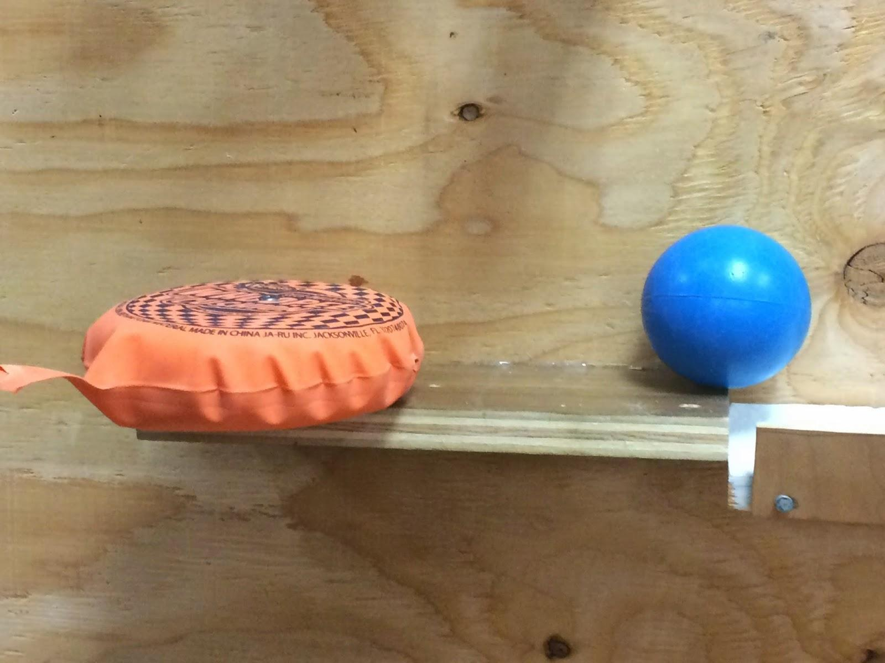
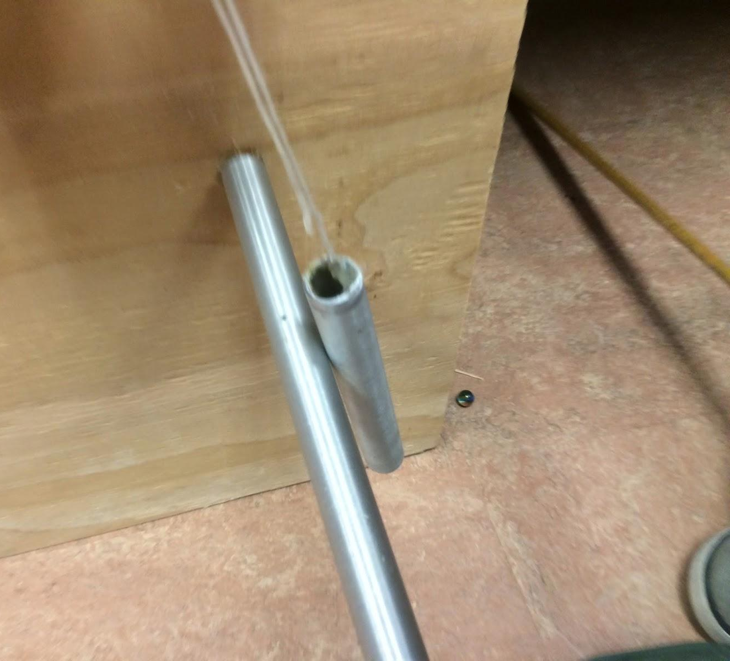
Steps 9 and 10: Ending 1- Part 2 and Ending 2
Step 9: Ending 1- Part 2: The Bell
Step 10: The Finale - Ending 2
After the tennis ball hits the metal and it falls down, it clangs against another rod attached to the wall making a bell-like noise. This is ending 1 of 2 in our Rube Goldberg Machine. The amount of energy that goes into heat and sound is 0.1564J
Going back to Step 7, the lever lifts hitting a ball. This ball now rolls along a platform knocking into a whoopie cushion, which falls onto a chair, which Ryan will sit on. The force required to activate the whoopie cushion is 53 N.

Slide 7
Our Energy Transfers
Transfer 1: Potential to Kinetic
When the marble reaches the top of the elevator, its energy is Potential Energy. When it is released into the funnel and screw, this turns into Kinetic Energy.
Transfer 2: Kinetic to Kinetic
As the marble comes down the screw, it gains Kinetic Energy. When it hits the block at the bottom, this transfers over the Kinetic Energy from one item to another.
Transfer 3: Kinetic to Potential
When you crank the marble elevator, it lifts a marble up it. This transfers the Kinetic Energy of your hand cranking into Potential Energy of the marble gaining height.
Transfer 4: Kinetic to Heat:
As I previously mentioned, the marble goes down a screw. As it goes down, 83% of its force is lost to friction. This force lost to friction turns into heat.

Slide 9
Thank You For Watching!!!
Spencer Shifs, Simon Swetland, Ryan Tavenner, and Sarah Teel
Music:
Tristam: Once Again
Tristam & Braken: Frame of Mind

